Slide 1


Nonverbal Communication (Ref: Waqas Khan)
TRƯỜNG ĐẠI HỌC BÁCH KHOA HÀ NỘI
HANOI UNIVERSITY OF SCIENCE AND TECHNOLOGY
SoICT - 2020

Slide 2
Content
What is nonverbal communication?
Difference between verbal & nonverbal communication.
Importance & Power of nonverbal communication.
Types of nonverbal communication.
Forms of nonverbal communication.
Nonverbal Communication Around the World.
Nonverbal communication must be understandable.

Slide 3
What is nonverbal communication?
Nonverbal Communication = Communication without words
Nonverbal communication is a process of communication through sending and receiving wordless messages.

Slide 4
Verbal & Nonverbal communication
Before moving forward, let’s keep in your mind that verbal communication and nonverbal communication are interconnected and they operate together in communication.
Verbal and non verbal are all types of communication. But the difference between them is that we use our voice in verbal communication and we use body signs in non-verbal communication.

Slide 5
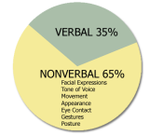
Importance of Nonverbal Communication
Verbal & nonverbal Communication plays an important role in how people interact with one another. People are using around 35% verbal communication and 65% nonverbal communication in daily life. Nonverbal communication has also cultural meaning.
“The most important thing in communication is to hear what isn’t being said.”
Peter F. Drucker

Slide 6
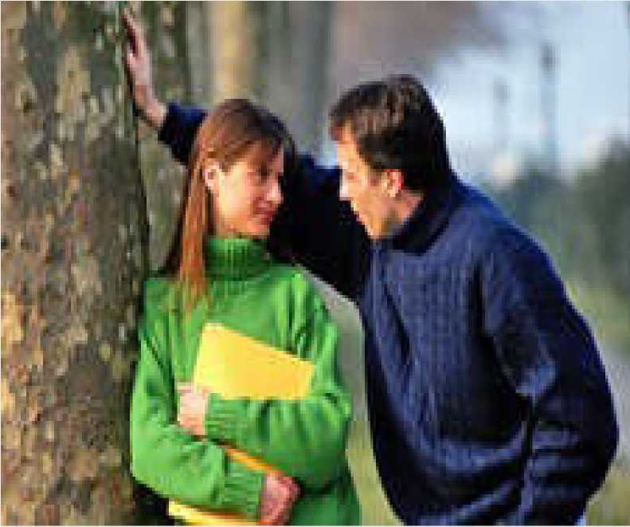
Power of nonverbal communication
Nonverbal communication is the most powerful form of communication. More than voice or even words, nonverbal communication helps to create your image in others mind and even you can express your emotions and feelings in front of others, which you are unable to express in words.

Slide 7
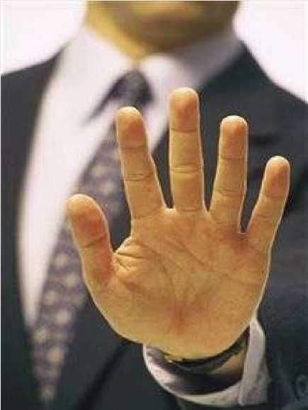

Types of Nonverbal Communication
There are two types of nonverbal communication:
Intentional nonverbal communication
Example: Pointing out the finger, giving smile and clapping.
Unintentional nonverbal communication
Example:...................?
This may be intentional or unintentional nonverbal communication message?
Notes:
Intentional: Chủ ý

Slide 8
Form of nonverbal communication
Eye Contact
Facial Expressions
Posture
Haptics or Touch
Gestures
Personal Space

Slide 9
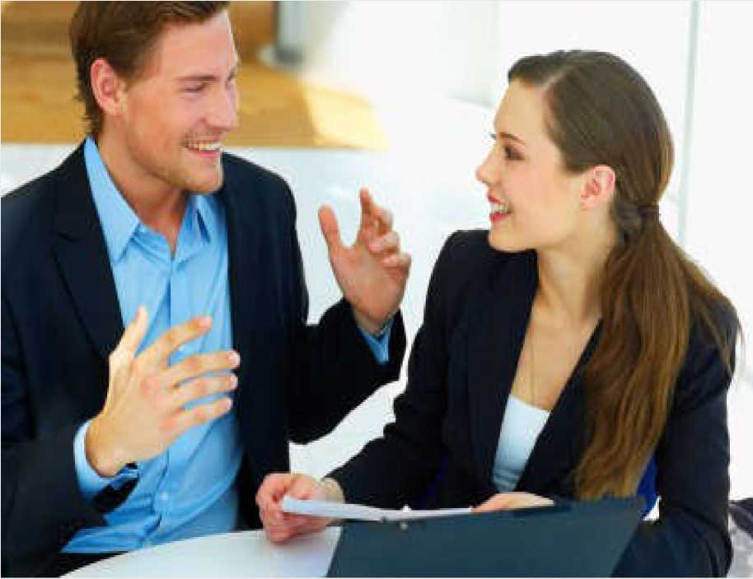
Eye Contact
Eye contact, a key characteristic of nonverbal communication, expresses much without using a single word. In American culture, maintaining eye contact shows respect and indicates interest.
Eye contact also establish the nature of a relationship.

Slide 10
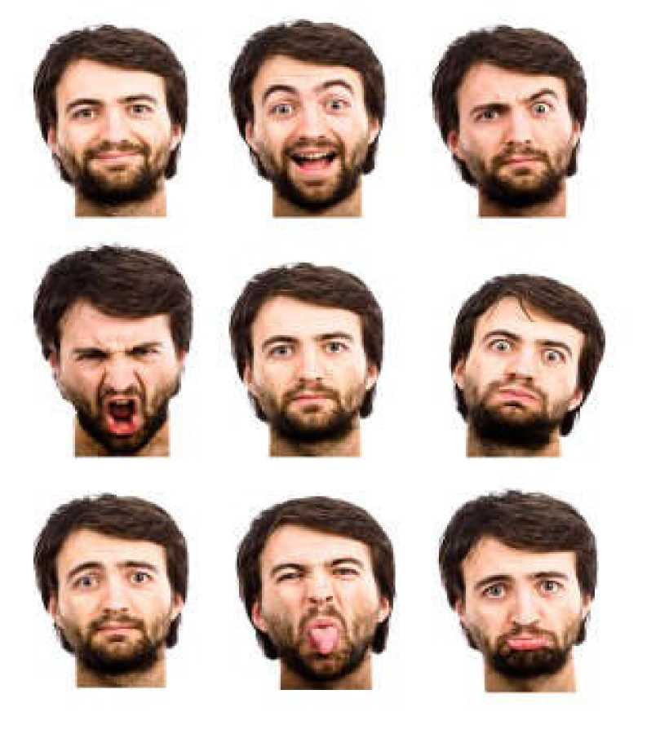
Facial Expressions
Facial expressions are the key characteristics of nonverbal communication. Your facial expression can communicate happiness, sadness, anger or fear.

Slide 11
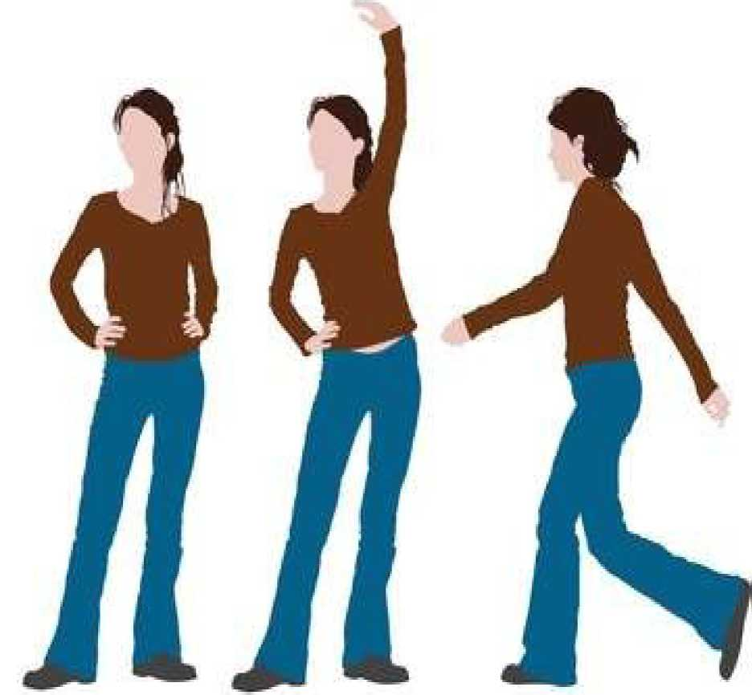
Posture
Posture and how you carry your self tells a lot about you. How you walk, sit, stand or hold your head not only indicates your current mood, but also your personality in general.
For example, if you cross your arms while standing, you indicate that you may be closed off and defensive. Meanwhile, walking with your head down and avoiding eye contact with others may indicate shyness.
Notes:
Shyness: nhút nhát

Slide 12
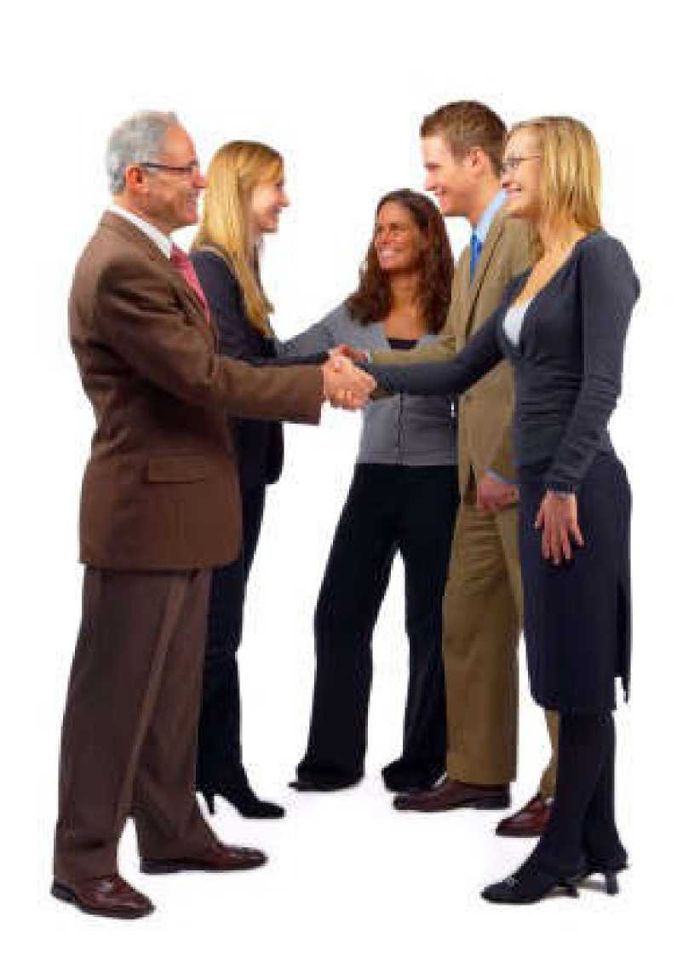
Haptic or Touch
Haptic communication is communicating by touch. Touch or Haptic is the characteristic of nonverbal communication and used when we come into physical contact with other people.
For example: We use handshakes to gain trust and introduce ourselves.

Slide 13
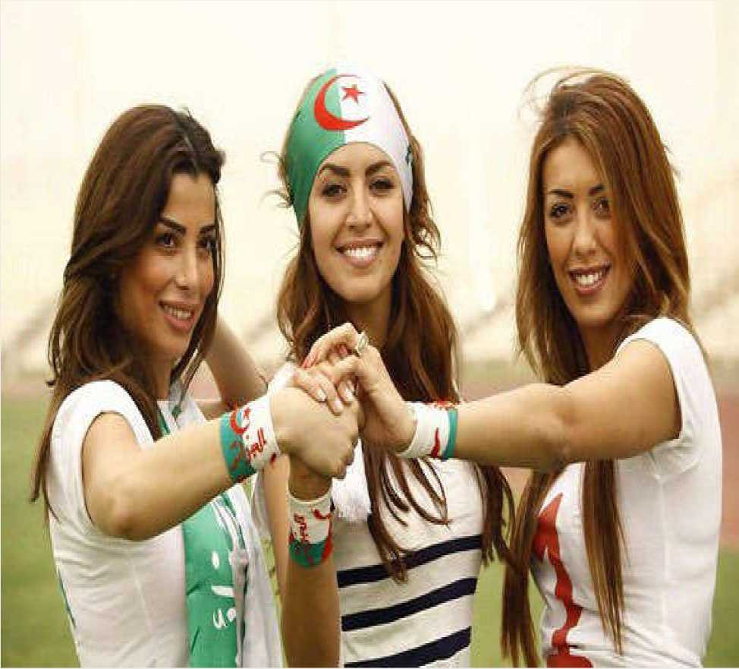
Gestures
A gesture is a characteristic of nonverbal communication in which visible body actions communicate particular message.
Gestures include movement of the hands, face, or other parts of the body.
Notes:
Gesture: Cử chỉ

Slide 14
Let see some most common gestures

Slide 15
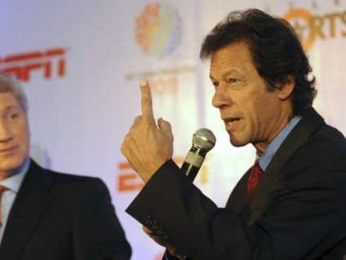

Slide 16
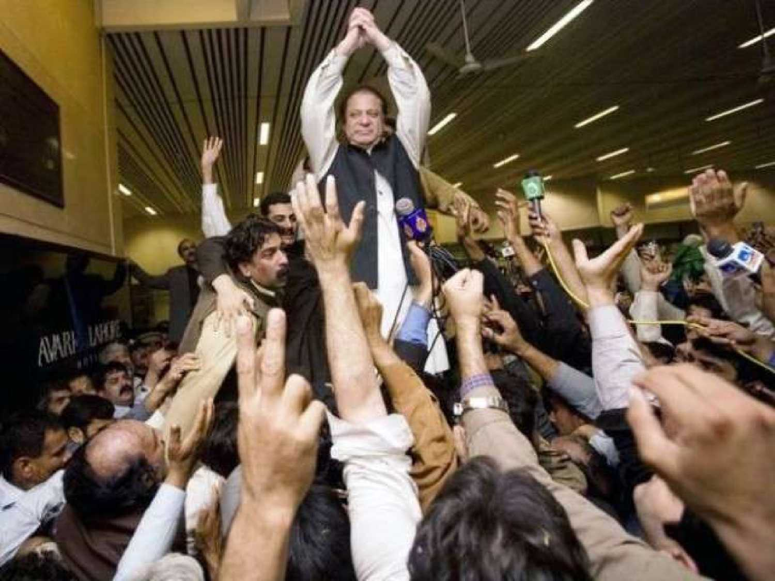

Slide 17
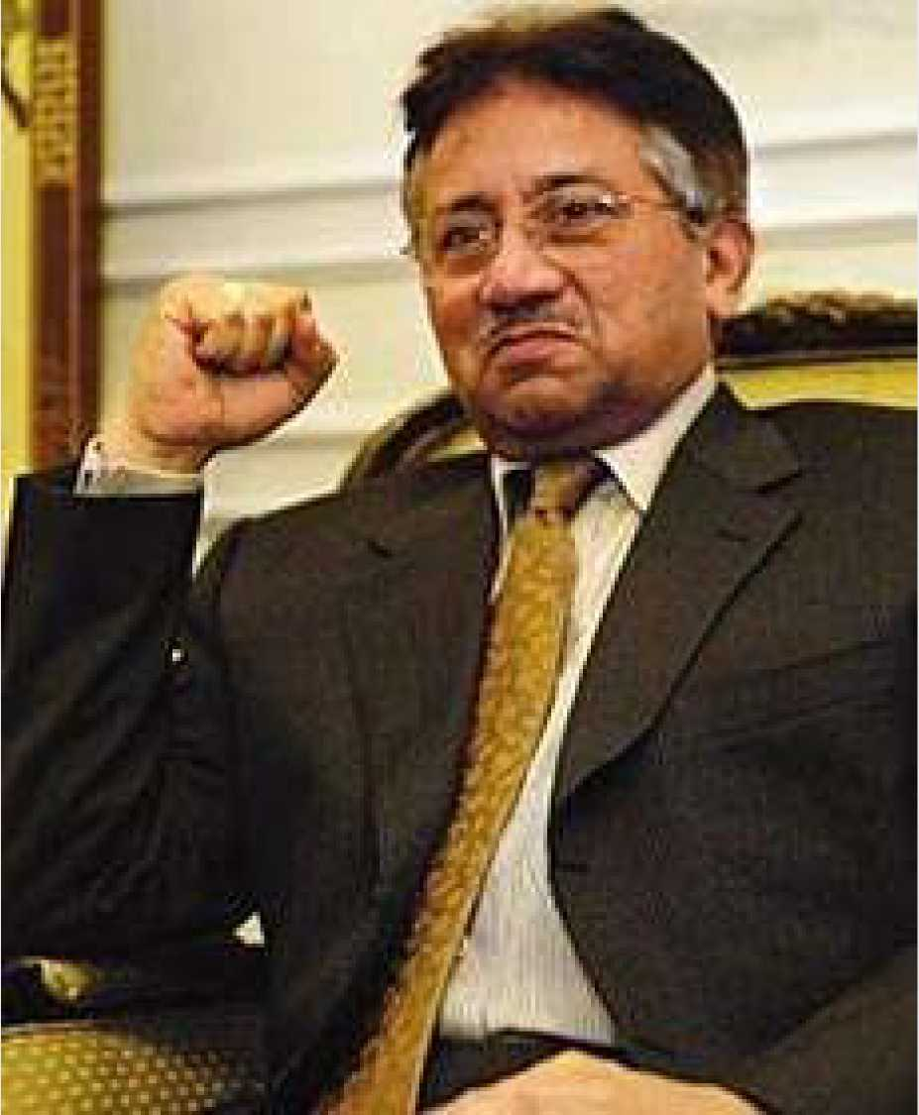

Slide 18
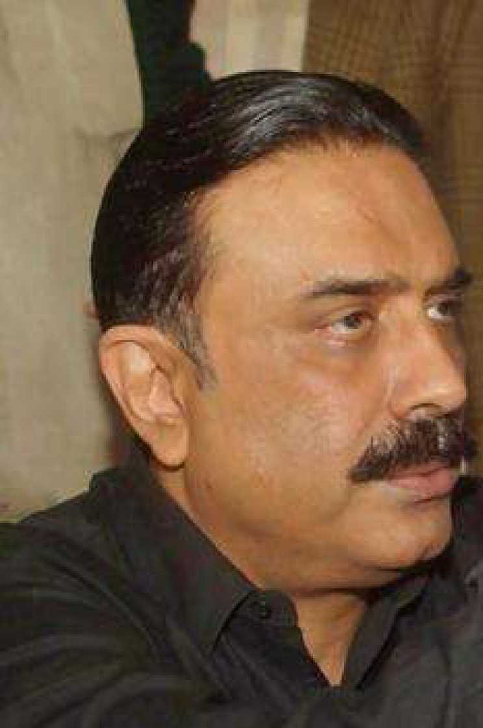
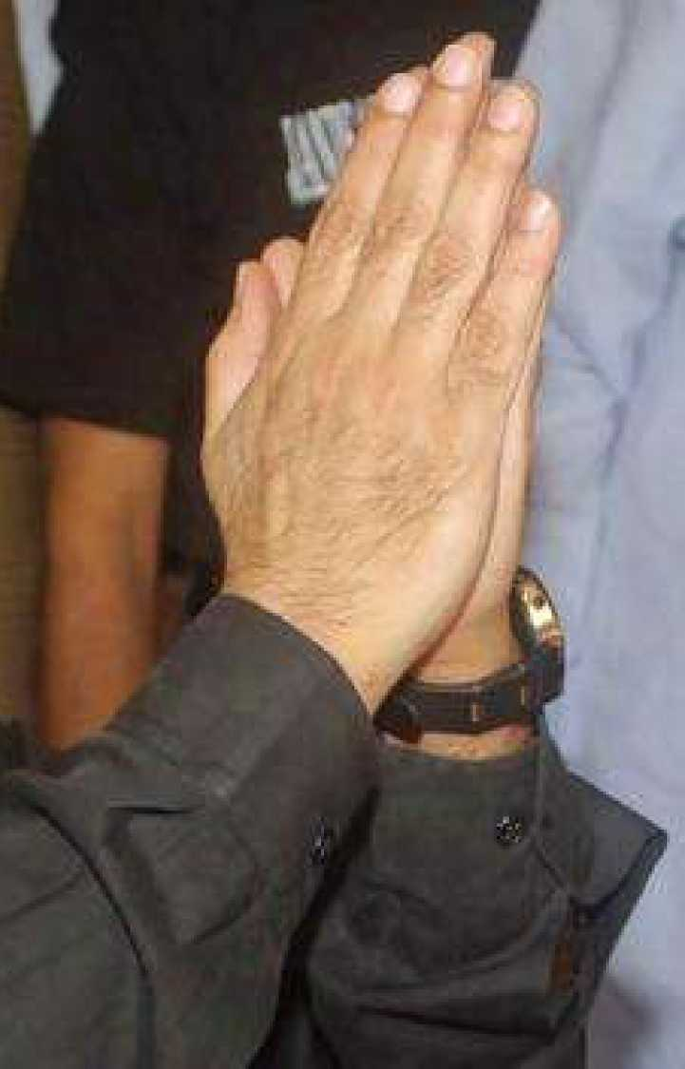

Slide 19
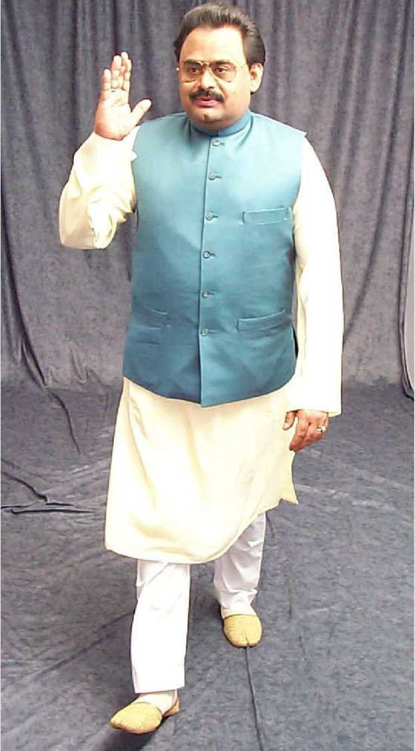

Slide 20
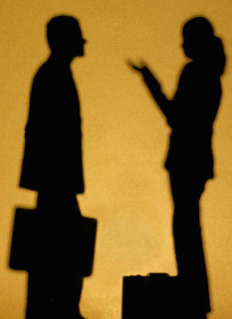
Personal space
Personal space is your "bubble" - the space you place between yourself and others. This invisible boundary becomes apparent only when someone bumps or tries to enter your bubble.

Slide 21
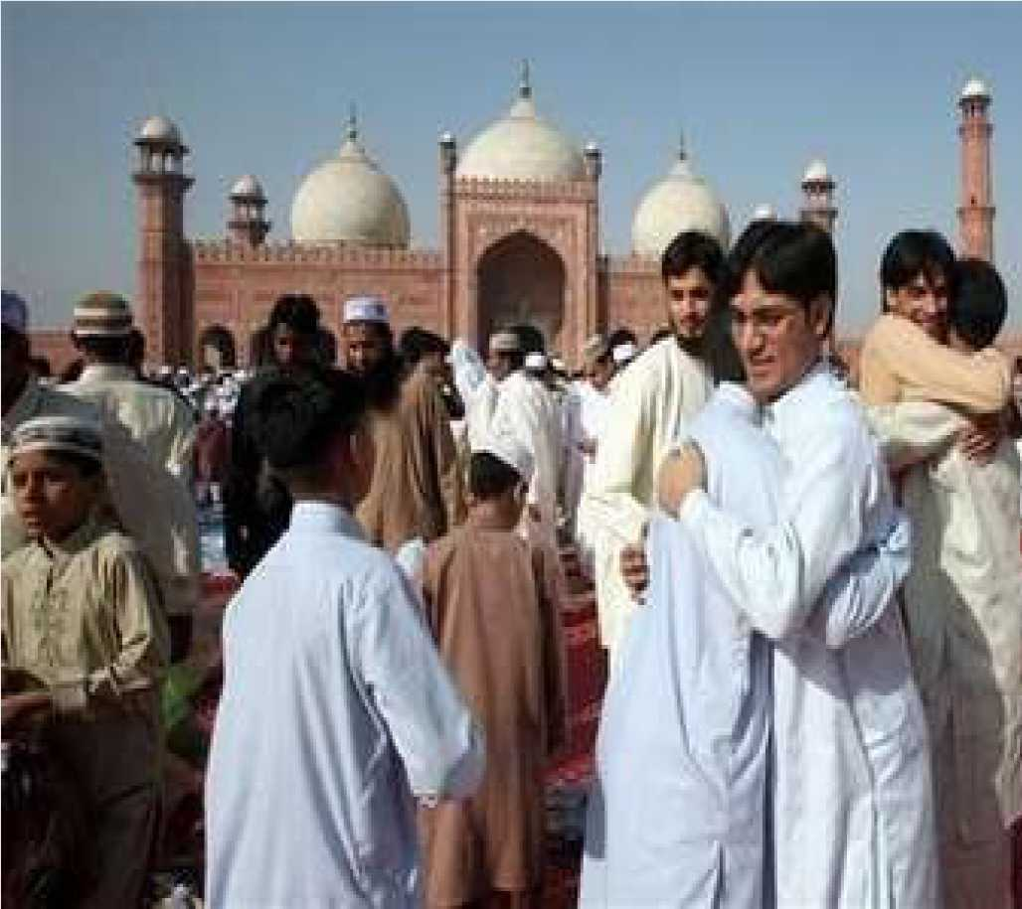
Nonverbal Communication Around the World
Nonverbal Communication in
Pakistan
Expressing happiness, respect and love for others.

Slide 22
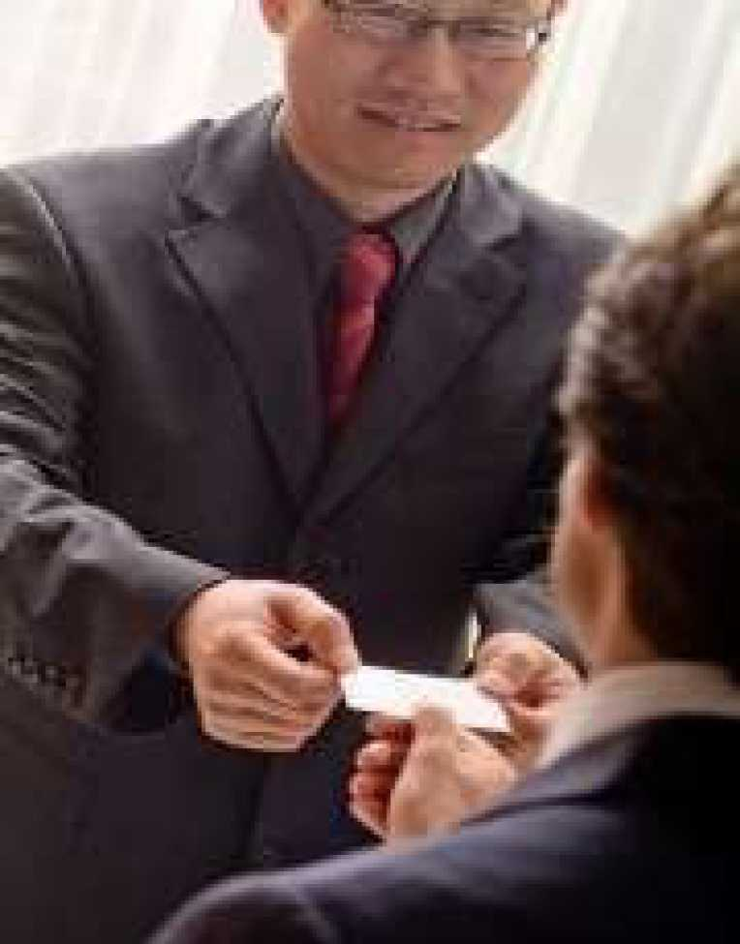
Nonverbal Communication Around the World
Nonverbal Communication in
China
The Chinese don't like being touched by strangers. Therefore don’t make any body contact.

Slide 23
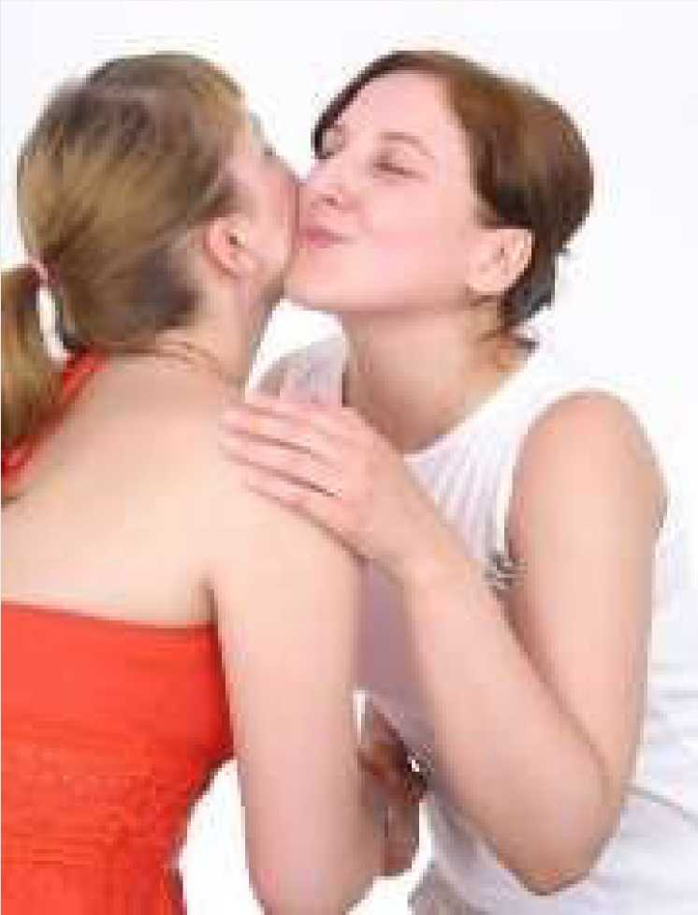
Nonverbal Communication Around the World
Nonverbal Communication in Argentina
A handshake and nod show respect when greeting someone.

Slide 24
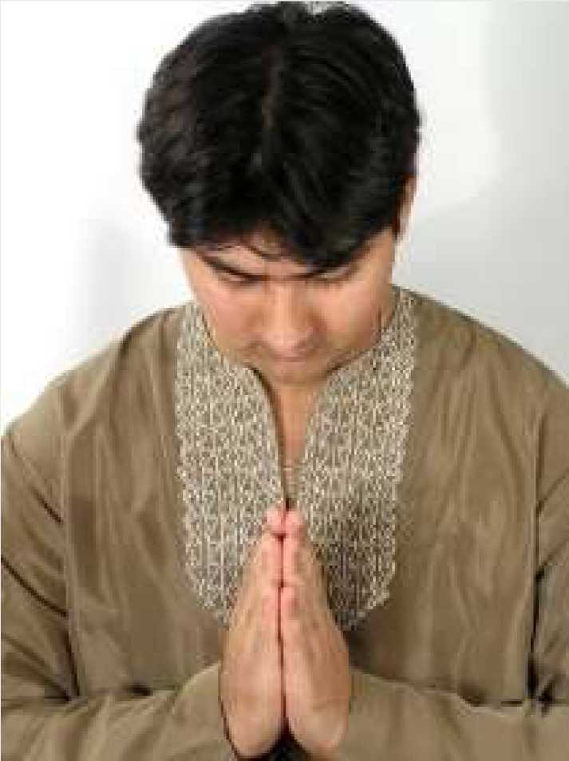
Nonverbal Communication Around the World
Nonverbal Communication in India
Greeting with 'namaste' -placing both hands together with a slight bow is a very common nonverbal communication and shows respect.

Slide 25
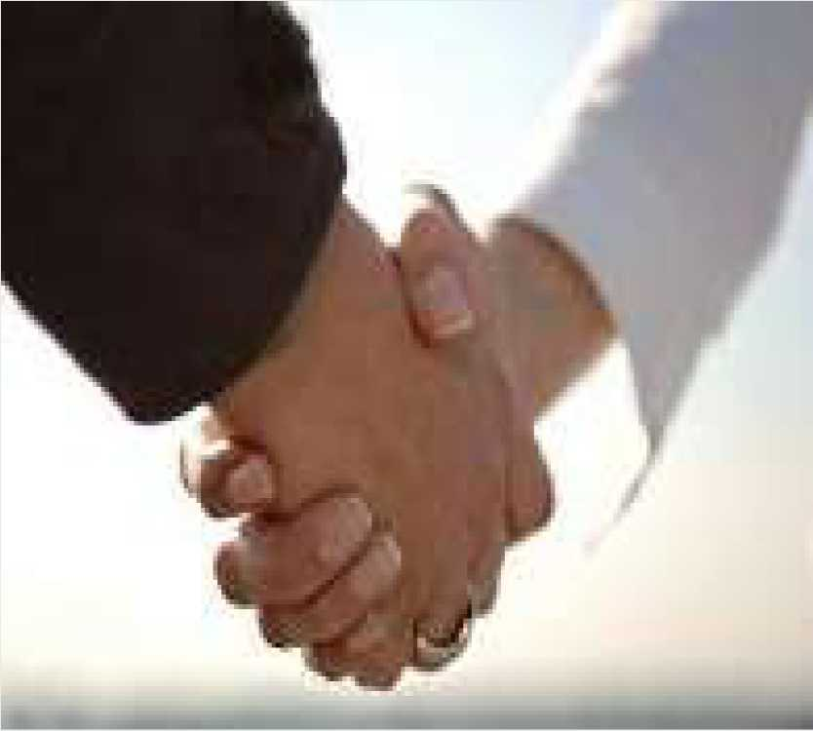
Nonverbal Communication Around the World
Nonverbal
Communication in the
U.S.A
Quite Informal way of nonverbal communication - A handshake, a smile, and 'hello'.

Slide 26
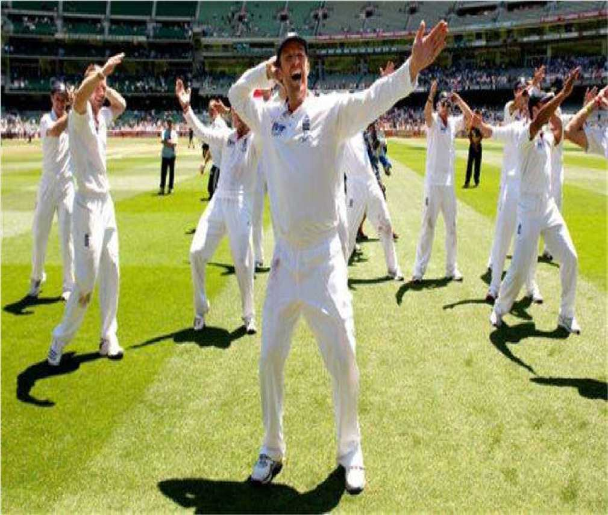

Nonverbal Communication must be understandable
But what the........is this?
Chicken Dance
Dance is an artistic form of nonverbal communication. But no one really knows what England’s creepy chicken dance is trying to communicate.
I just understand that they are happy.

Slide 27
Body Language

Slide 28
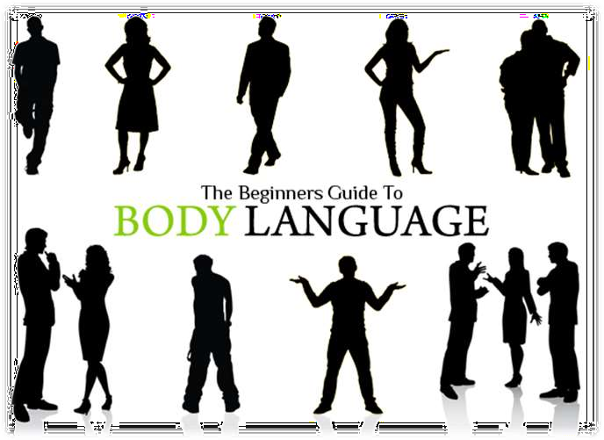
What is body language?

Slide 29
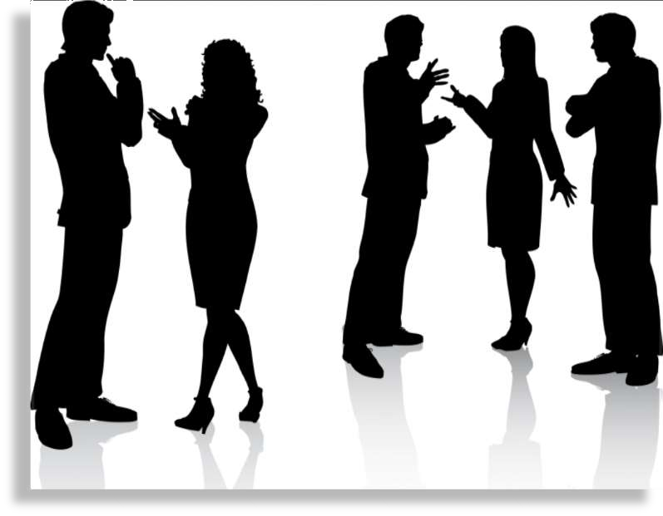
Body Language is:
What is body language?
Body language is the non-verbal communication that involves body movement.
Gesturing can also be termed as body language which is an absolutely non-verbal mean of communication.
People in the workplace can convey a great deal of information without even speaking; through nonverbal communication.

Slide 30
Body Language is:
How does body language talk?
Like any spoken language, body language has words, sentences and punctuation.
Each gesture is like a single word and one word may have several different meanings.

Slide 31
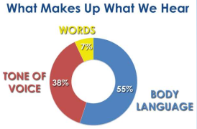
Importance of body language?
Body language plays a big role in intuition as it gives us messages about the other person, that we can interpret at an intuitive level.
10
Notes:
Intuition: trực giác

Slide 32
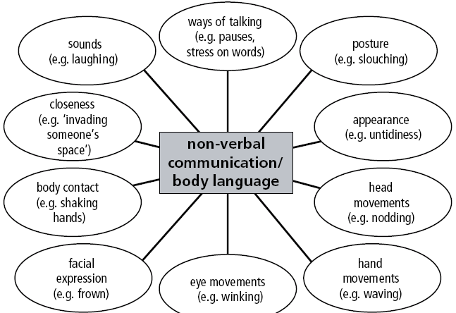
Nonverbal communication/body language
11

Slide 33
Basic body languages
Eyes
Blocking
Hands
Animations
Smile

Slide 34
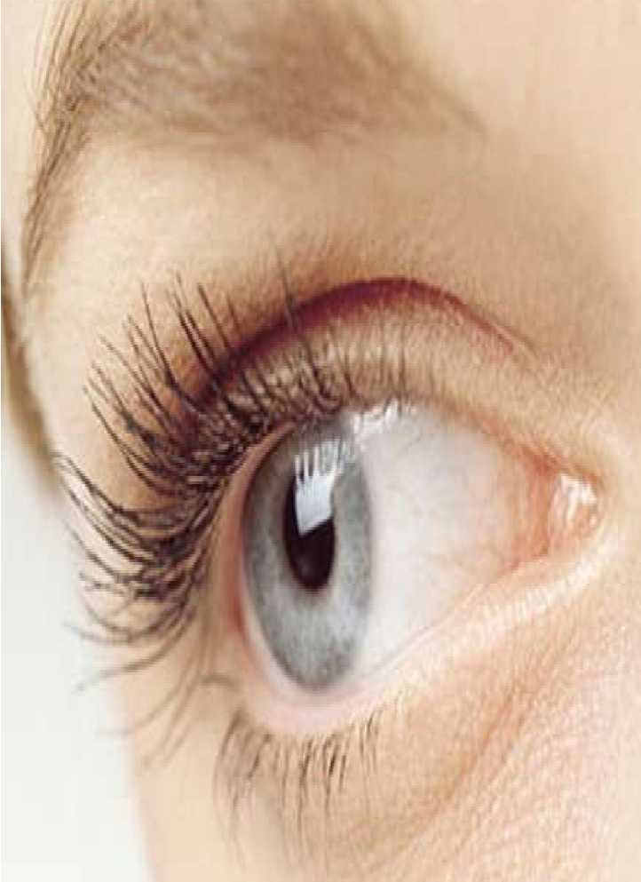
Eyes
Common mistake: Taking your eyes off of listeners.
Do you read directly from a PowerPoint presentation instead of addressing the audience?
In a one-on-one conversation, do you glance to the side, down at your feet, or at the desk?
Ever catch yourself looking over the shoulder of the person you’re talking to?

Slide 35
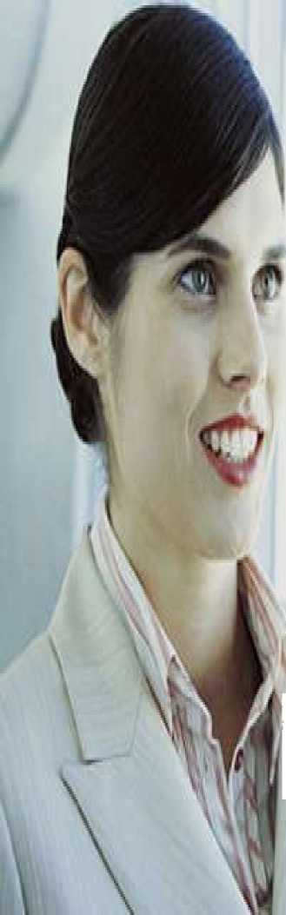
Eyes
Keeping your eyes on your audience.
If you’re giving a presentation, commit your material to memory so you can connect instead of read.
In small groups or meetings, maintain eye contact equally with everyone in the room.
During one-on-one conversations, keep your eyes on the person you are speaking to 80% to 90% of the time.

Slide 36
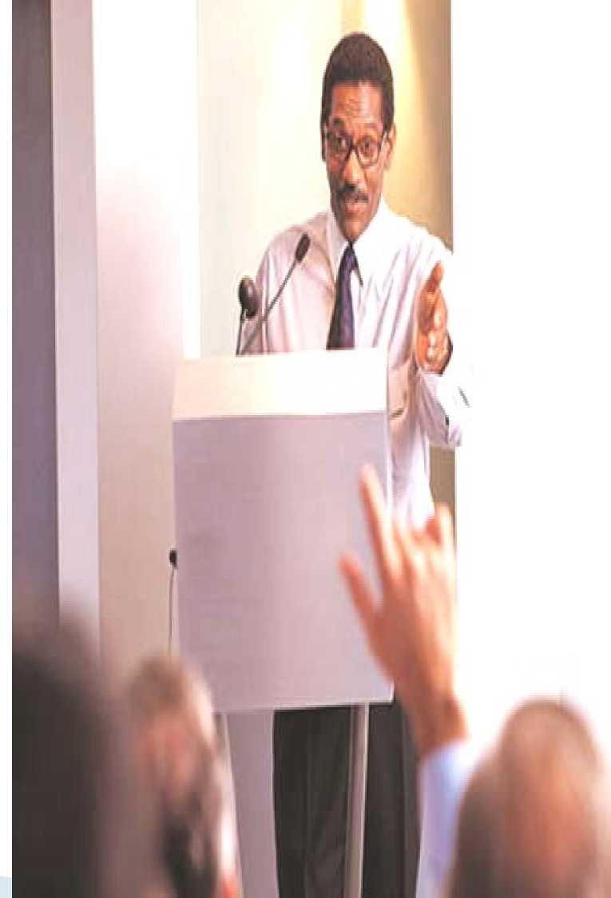
Blocking
Common mistake: Putting something between you and your listener (s).
Crossing your arms
Standing behind a podium, Standing behind a chair
Talking to someone from behind a computer monitor

Slide 37
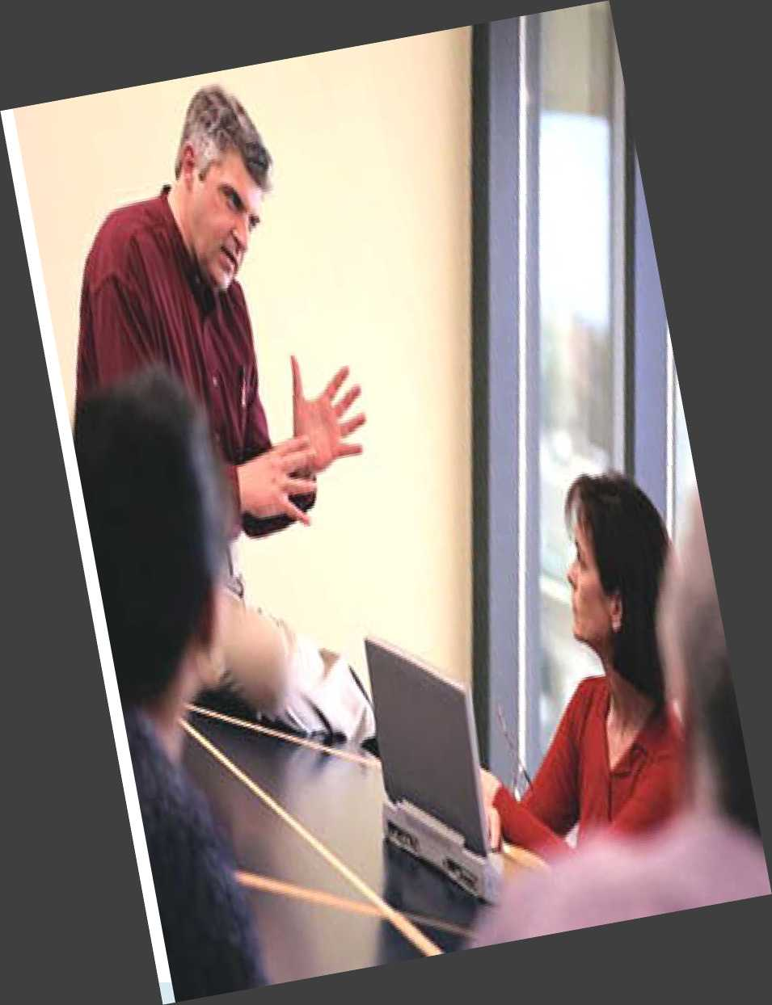
Blocking
Staying "open"
Keep your hands apart and your palms up, pointed toward the ceiling.
Remove physical barriers between you and your listeners.
Notes:
Giữ hai bàn tay cách xa và lòng bàn tay hướng lên, hướng lên trần nhà. Xóa bỏ rào cản vật lý giữa bạn và người nghe.

Slide 38
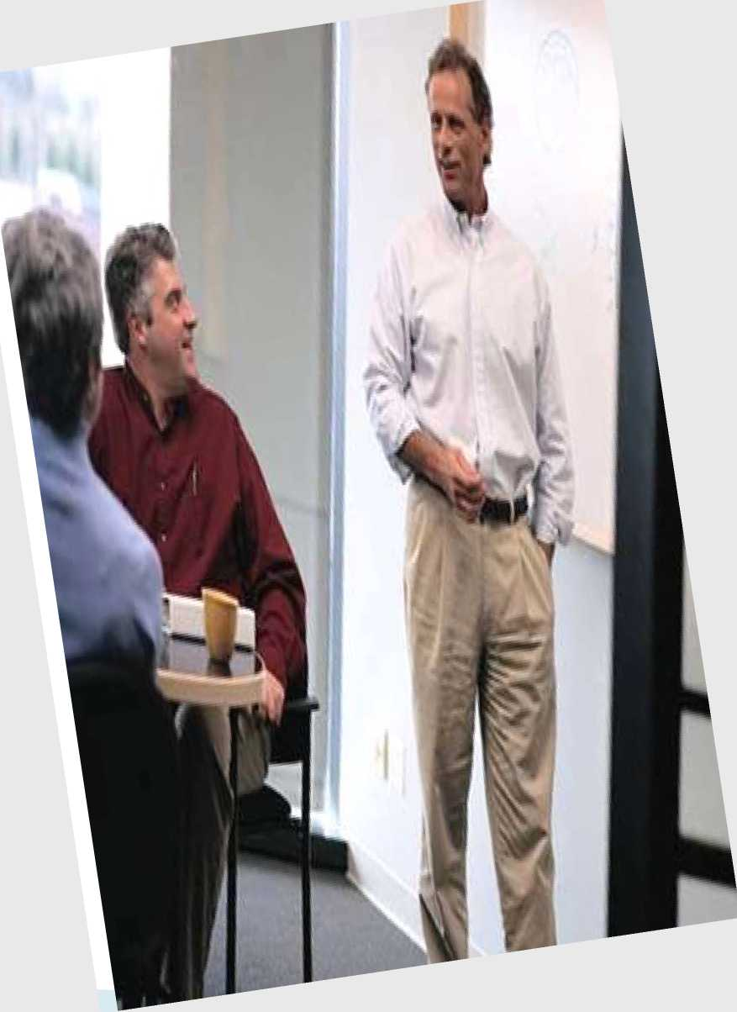
Hands
Common mistake: Not using them.
Keeping your hands in your pockets or clasped together makes you seem stiff, stilted, and formal.
It conveys insecurity, whether or not you’re insecure.
Notes:
Giữ tay trong túi quần hoặc siết chặt với nhau khiến bạn có vẻ cứng nhắc, cứng nhắc và trang trọng. Nó truyền đạt sự bất an, cho dù bạn có bất an hay không.

Slide 39
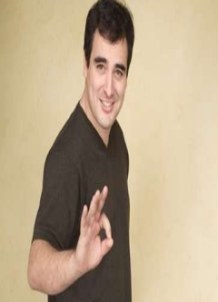
Hands
Using complex hand gestures.
Engaging both hands above the waist reflects complex thinking and gives the listener confidence in the speaker.
Just watch such charismatic speakers as Bill Clinton, Colin Powell, Barack Obama, or Tony Blair.

Slide 40
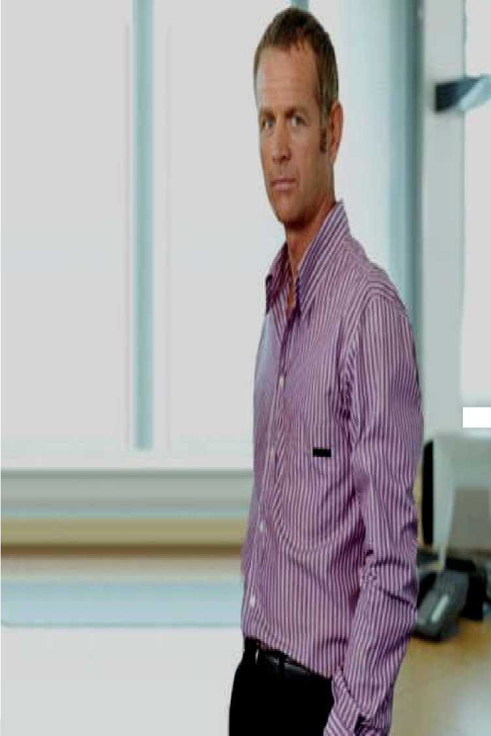
Animation
Common mistake: Standing or sitting perfectly still.
Ineffective speakers barely move, staying in one spot during a presentation.

Slide 41
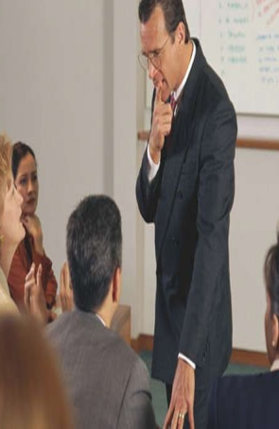
Animation
Animate your body, not your slides.
Great speakers get up and move
When appropriate, mingle with the audience,
Notes:
like Cisco Chief Executive John Chambers, who often walks into the audience as he speaks.
Hòa nhập với khan giả

Slide 42
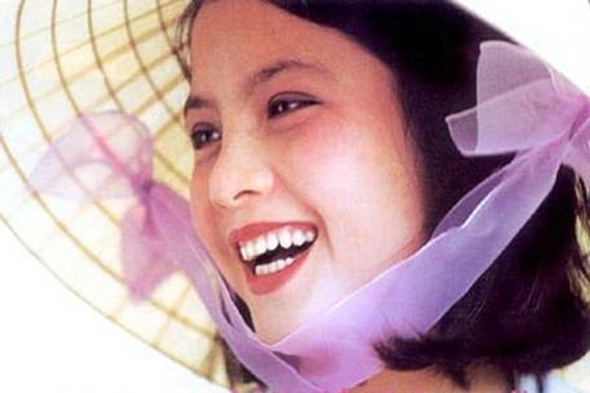
Smile
Mahatma Gandhi has also mentioned that,
"You are not completely dressed until your face wears a SMILE

